Slide 1
Notes:
by amores

Slide 2
1. Listen and then choose one pokémon and write the word or sentence.
1
2
3
2. If your pokémon is in the pokéball, you get a point!

Slide 3
grate
grope
grade
grad
grape

Slide 4
grape

Slide 5
prime
brim
brine
prim
brime

Slide 6
prime

Slide 7
score
scare
scape
scar
scup

Slide 8
score

Slide 9
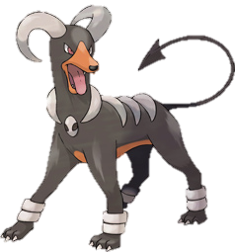
rash
trash
thrash
rush
trush

Slide 10
rush

Slide 11
blend
blank
blink
bank
blind

Slide 12
blank

Slide 13
shut
shot
shop
ship
shup

Slide 14
shot

Slide 15
drive
dive
drove
dove
druve

Slide 16
drive

Slide 17
chip
chirp
chin
chimp
churn

Slide 18
chimp

Slide 19
spur
spare
spore
spar
spire

Slide 20
spare

Slide 21
dart
art
chart
part
tart

Slide 22
chart

Slide 23
You’ve caught them all!

Slide 24
How to edit this game:
Delete, add, and change the size of the boxes easily. Copy entire slides to make the game longer or add more of a certain type.
Changing the pokémon that comes out of the pokéball:
Delete the current pokémon and paste in the new one. Reproduce the sequence as follows: 1) Open Pokeball fades in [밝기 변화]. 2) Closed Pokeball fades out [밝기 변화] with previous [시작: #2]. 3) Your new Pokemon appears [나타내기] after previous [시작: #3]. 4) Pokemon follows line (motion path) [선] after previous for a duration of .25 seconds [재생 시간]. 5) Word box fades in after previous.

Slide 25
How to edit this game:
3. Using the spare pokémon bank: Copy the new pokémon AND its box in order to have the exact shade. Some pokémon have several boxes for you to choose from.
4. Acquiring the exact shade for pokémon found elsewhere: PowerPoint 2013 has a color dropper under the color menu. Otherwise, install any Color Eye Dropper app for Google Chrome. Old school method: Paste the picture into Microsoft Paint and use the eye dropper tool. On a Korean computer, this should be in the 보조프로그램 folder. The program is called 그림판.
5. Removing the background of a picture: Click on the picture. Navigate to 배경 제거 in the 서식 menu. Resize the selection box to include the entire pokémon. Use the pencil to add (+) or subtract (-) areas. To accept the changes, click away or click the green check mark. To delete all changes, click on the recycling bin.
6. Pokedex: http://pokemondb.net/pokedex/national

Slide 26
Spare Pokémon

Slide 27
Spare Pokémon

Slide 28
Spare Pokémon

Slide 29
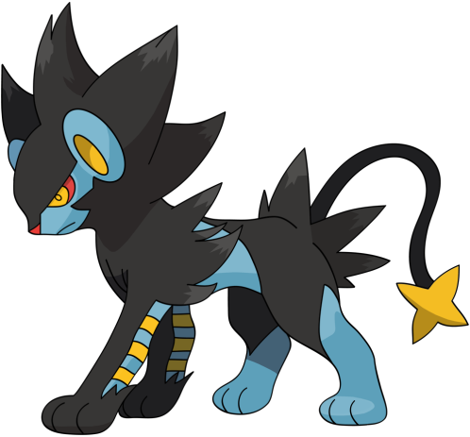
Spare Pokémon

